Slide 1
Statistical Analysis
U5 – Analyse
E1 – Exploratory Data Analysis
The element ‘Exploratory Data Analysis’ describes the predictive models using regression techniques to determine the relation between factors on a response. This element also covers process performance metrics and the method for determining the capability of a process to meet specifications.
Yellow Belt
Notes:
Welcome to the Statistical Analysis Module.

Slide 2
Statistical Analysis
Correlation analysis
  Correlation studies the degree of correlation between two variables
  Correlation does not mean that there is a cause and effect relation
  Example:
  Is there a correlation between the age of the patient and efficiency of the administred drug?

Slide 3

Statistical Analysis
Correlation coefficient
  The Pearson correlation coefficient is used to measure the strength of the linear relationship between two variables
  The correlation coefficient assumes a value between -1 and +1
Notes:
Once we have determined the relationship between the variables with a regression analysis, we can then use correlation to look at the strength of this relationship. For a linear relationship we use the ‘Pearson correlation coefficient’. This assumes a value between -1 and +1, depending on the kind of relation between the variables. Here we can see different types of relations as depicted by clouds of points and the corresponding correlation coefficient.

Slide 4
Statistical Analysis
Correlation coefficient
  The correlation coefficient (R) lies between -1 and +1
  ‘-1’ depicts complete inverse (negative) dependence
  ‘0’ depicts complete independence
  ‘+1’ depicts complete direct (positive) dependence
  General Rules
  Strong : correlation coefficient |R| > 0.8
  Moderate : correlation coefficient 0.5 < |R| < 0.8
  Weak : correlation coefficient |R| < 0.5
Notes:
As seen in the previous slide with the clouds of points, the correlation coefficient indicated the strength and the direction of the relation. If the correlation coefficient is zero, we can say that there is no relation between the variables. At the moment that all points lie on the line, the value will be -1 or +1. We call this a ‘directly proportional dependence’ when the value is +1 and an ‘inverse dependence’ when the value is -1.

Slide 5
Statistical Analysis
Regression Analysis
  Regression analysis investigates the relationship between cause and result
  Examples:
  When temperature increases, the process runs faster
  As you get older, more accidents happen
  The warmer it gets, the more ice-cream people eat
Notes:
Regression analysis investigates the relationship between cause and result
Here we can see some response examples with corresponding factors. For instance, in a chemical reaction the speed of the process will be faster if we increase the temperature. It is important that there is a logical explanation for the relation between response and factor. If we want to use a regression analysis, there must be causality between response and factor.

Slide 6
Statistical Analysis
Factor and response
  The ‘Factor’ is the independent variable X
  The ‘Response‘ is the value that changes as a result of a changing ‘Factor’
  The ‘Response’ is the dependent variable Y
Response Y
(Effect)
Factor X
(Cause)
Notes:
The graph shows us the relationship between the variables and it also indicates if there is indeed a linear relationship between the X and Y variables. When using regression, we first try using singular linear regression. If we can see clearly in the graph that the relation is not linear, there are other forms of regression that we can possibly use, such as a quadratic relationship.

Slide 7
Statistical Analysis
Mathematical context
  Regression analysis indicates the relation between the dependent Response (Y) and the independent Factor (X)
  Singular Linear Regression investigates the relation between
  one continuous Y and one continuous X
Regression line
Notes:
The mathematical formula for a singular linear relation is represented by the equation Y = AX + B. In the graph, this is shown as the Shear = 32 + 0.98 times the temperature. In the fitted line plot, we can also see how much of the variation of Y can be explained by the variation in X. This is shown as the value of ‘R squared’ or ‘R sq.’, which is 96.2%. If the R squared is 100%, then all of the variation of Y is explained by the variation in X.

Slide 8
Hypothesis Testing
U5 – Analyse
E2 – Hypothesis Testing
The element ‘Hypothesis testing’ reviews test methods that are used to test a hypothesis. This element also discusses Confidence Intervals that indicate the reliability of test conclusions.
Yellow Belt
Notes:
Welcome to the Hypothesis Testing module

Slide 9
Hypothesis Testing
Hypothesis
A hypothesis is a statement that something is true:
  Based on this hypothesis, we predict the expected outcomes of the test
  If the outcome of the test has a low probability (unlikely), we will reject the hypothesis
  However, there will always be a chance that we reject a true hypothesis
Notes:
Testing of a hypothesis can be compared to the justice system. We have a certain null-hypothesis, which we could compare to an innocent suspect. We use the alternative hypothesis to show a difference. With projects for instance, the null-hypothesis is the situation in the beginning of the project and the alternative hypothesis describes the improved situation after the project. We must then prove beyond reasonable doubt that the situation is indeed improved.

Slide 10
Hypothesis Testing
Hypothesis testing
In processes, we test hypotheses in the same way:
  We do not want to react to common cause variation
  We only want to react to uncommon (special cause) variation
  In our example of the Elderly home centre:
  We do not want to replace the stove when the variation was caused by not efficient walking routes
  We do want to replace the stove when this was the cause of the high variation in the temperature of the meals
Notes:
In processes we do not want to react to common cause variation for example in the meal example in the elderly care home there is no point replacing the oven when the variation in meal temperature was caused by inefficient delivery routes.

Slide 11

Hypothesis Testing
Hypothesis testing
‘One is presumed innocent until proven guilty’
  This also applies to hypothesis testing:
  The null-hypothesis (H₀) always assumes there is no difference
  Even when we suspect that there actually is a difference!
  The alternative hypothesis (H_{a}) describes the difference
  This is an assumption that must be reviewed and proven
Notes:
Here we compare the testing of a hypothesis with the judgment in court. The null-hypothesis is that the suspect is innocent. But there exists a small chance that the suspect is convicted anyway, which we call a Type 1 error. The chance that this occurs is called the ‘alpha risk con’. In hypothesis testing, this risk is often set at 5%. The consequence is that a court convicts an innocent suspect.

Slide 12
Hypothesis Testing
Benefits of hypothesis testing
  Helps to carefully handle uncertainties
  Prevents subjective interpretations
  Helps when making risky decisions
  Statistically quantifies the uncertainty
Notes:
The benefits of hypothesis testing is that it helps handle uncertainties, and helps when making risky decisions.

Slide 13
Hypothesis Testing
Population
Sample
Population parameters
µ = Population mean
σ = Population standard deviation
Sample statistics
x̅ = Sample mean
s = Sample standard deviation
Sample
Notes:
If a sample is taken, the next step is to calculate the mean of the sample in the same way as for the population: the sum of all elements of the sample divided by the number of elements called small ‘n’. The mean of the sample is called X-bar. The standard deviation of the sample is the root from the squared distance of the elements to the mean of the sample, but in this case divided by n minus 1. We need to divide by n minus 1, because one degree of freedom is already used in calculating the mean of the sample. When we’re talking about samples, we are talking about an estimation of the population.

Slide 14
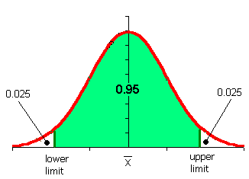
Hypothesis Testing
Confidence interval
  Statistics such as the average ( X̅ ) and standard deviation (s) of the sample are only estimators, not the real values!
  From sample to sample these estimates will differ
  A so-called confidence interval indicates how reliable the estimate is
  95% is often used as confidence level
Notes:
14
The statistical variables X-bar and small ‘s’ of the sample are not the true values of the population and will vary from sample to sample. The confidence interval, here visualized for a confidence level of 95%, indicates the borders between which we expect the location of the actual mean of the population. The probability that the actual mean lies outside the lower or upper limit is 2.5% for each limit.

Slide 15
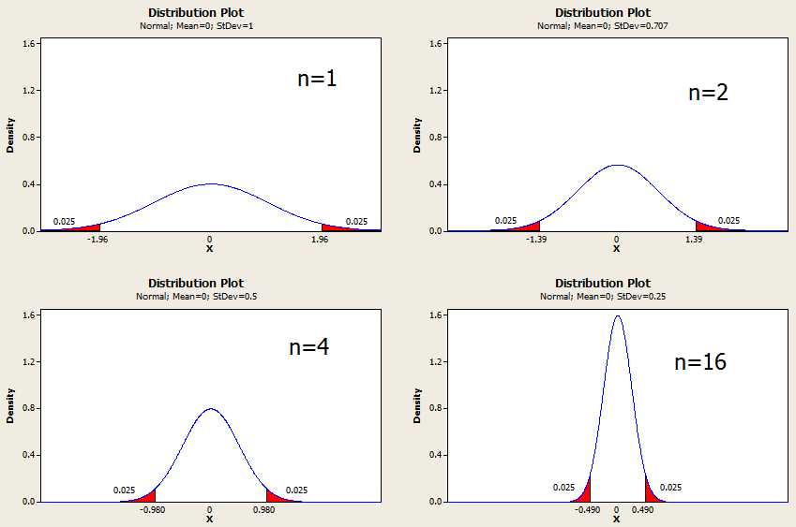
Hypothesis Testing
Influence of the sample size
Notes:
Here we can see the influence of the sample size shown as a test with a sample sizes of between 1 and 16. The confidence interval is depicted under the histogram. The scale is different however than the scale of the histogram. With a confidence level of 95%, the width of the confidence interval is clearly smaller with a sample size of 16 as compared to a sample size of 1..

